Slide 1


Student Placement Predictor
Jared Ahenkora-Kwakyi

Slide 2


Description and Machine Learning Problem
This dataset showed students program selection and the percentage of completion each of the students had when placement was determined.
Students were either determined as placed or not placed in University XYZ’s Business program
The machine learning problem that I had to determine the likelihood of a student being placed or not placed with their current program statistics being their final determining factor.

Slide 3
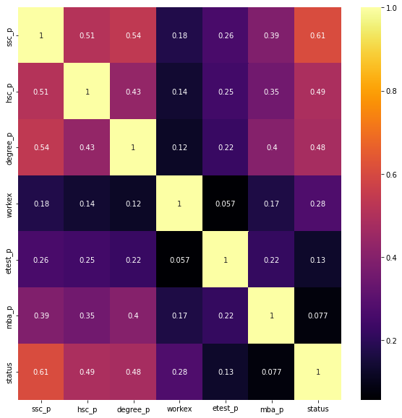
Correlation Heatmap
From this heatmap, We saw multiple strong correlations between specific columns and the placement status of a student.
Secondary Education percentage
Higher Secondary Education percentage
Degree Percentage
Work Experience had a smaller correlation, but It was enough for me to seriously consider it as a determining factor.

Slide 4
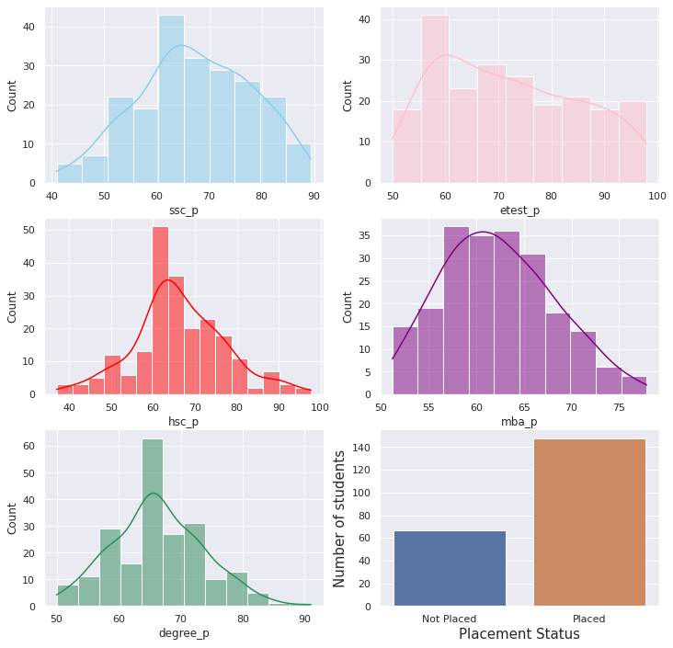
Histplots
This histplot was used to give me a quick understanding of where all the students fell in relation to different completion percentages for individual programs.
We also see a majorly unbalanced target are with a significantly higher number of placed students compared to those that weren’t placed.
We also see that a large majority of the students are midway through there degrees and education. What does this mean?
That told me that there was a combination of percentages that would lead to a student's placement. Not just if they completed a program vs. someone that did not.

Slide 5
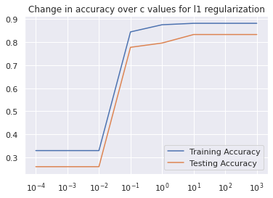
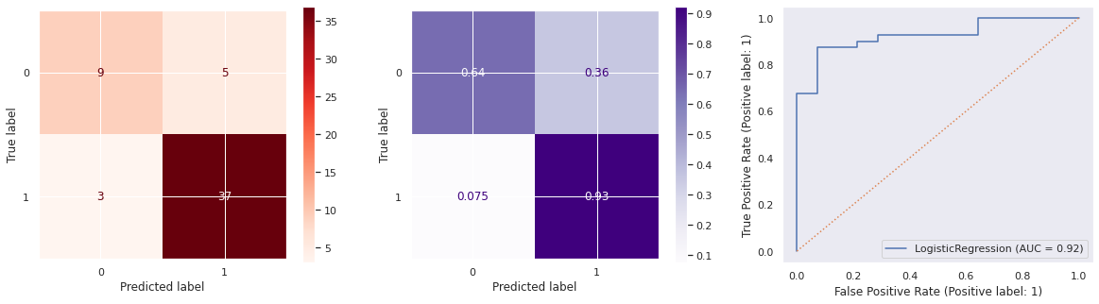
Final Production Model: L1 Regularization Logistic Regression Model
The best product to use for student prediction would be a logistic regression model with a l1 penalty
The l1 logistic regression model has good results:
Highest testing accuracy score amongst all other models
The least overfit model
Fewest false positives which is good because the model can limit the number of unqualified students the best out of all the models
The Area under the curve is .93 which means the model fairs well when it comes to clearly defining classes on its own.

Slide 6
What It Means
Applying this model to a group of incoming applicants will allow University XYZ to quickly determine which groups of students should be focused on when reviewing applications
The students in the predicted placed category can be quickly determined which will allow faculty to take more time to discern which students didn’t make the placed list as well as review any outlier circumstances those students could possibly have.
This model will open opportunities to more students being rightly placed in the long run because the statistical determination of placed students is already made. The Not placed students can be reviewed and receive information on which areas they may need to improve on after direct review from faculty.

